Slide 1
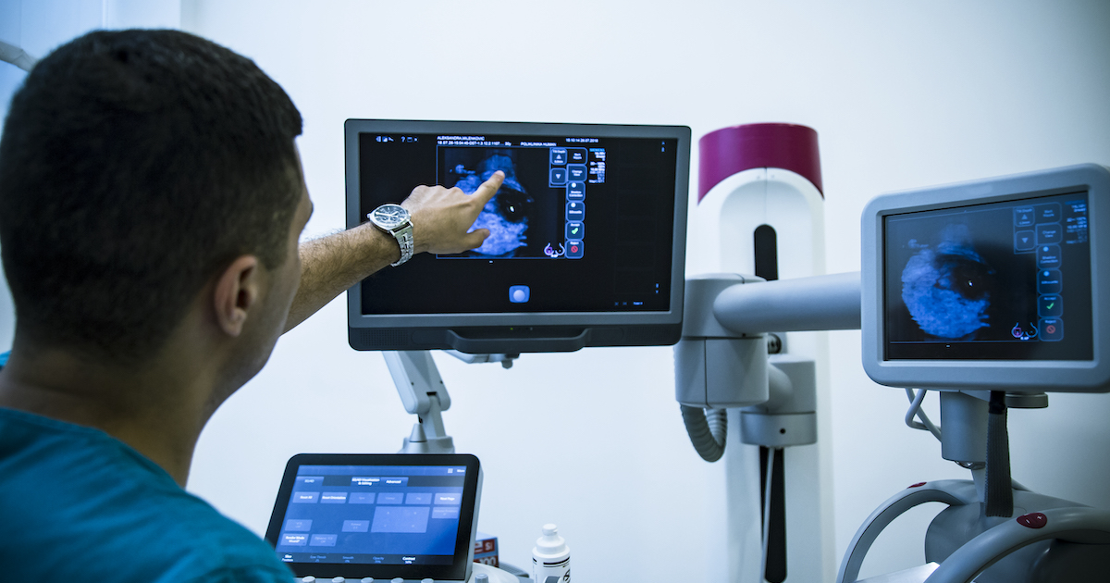


Finding informative regions in grayscale mammogram images.
Student : Arzu Fatullayeva
Instructors & Supervisors: Dr. Stephen Kaisler, Dr. Jamal Hasanov
Course#name: CSCI6917: Guided Research Methods
Date: 08.08.2023

Slide 2
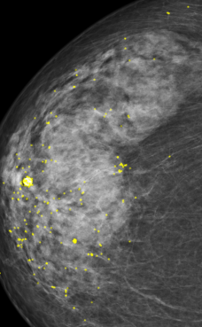
Project Objective:
The problem addressed in this research is the identification of informative regions in grayscale mammogram images and then classification of these images as negative or positive ones .
2

Slide 3
Heilmeier Questions
What are you trying to do?
Developing an approach to identify keypoints in mammogram images that contain relevant information for breast cancer detection and diagnosis.
How is it done today, and what are the limits of current practice?
Automated methods exist but often lack the ability to accurately locate informative regions
mammogram analysis is primarily performed manually by radiologists
What’s new in your approach and why will it be successful?
Building custom approach for feature extraction and training
Who cares? If you are successful, what difference will it make?
The work will benefit both radiologists and patients.
What are the risks and the payoffs?
Effectiveness of algorithms may be affected by the variability in image characteristics, leading to possible false positives or false negatives.
How much will it cost? How long will it take?
Team of 5 researchers.
No budget is required.
End of 2023.
What are the midterm and final exams to check for success?
Feature evaluation for midterm and classification for final.
Why now?
High demand, and there are no alternatives yet.
3

Slide 4
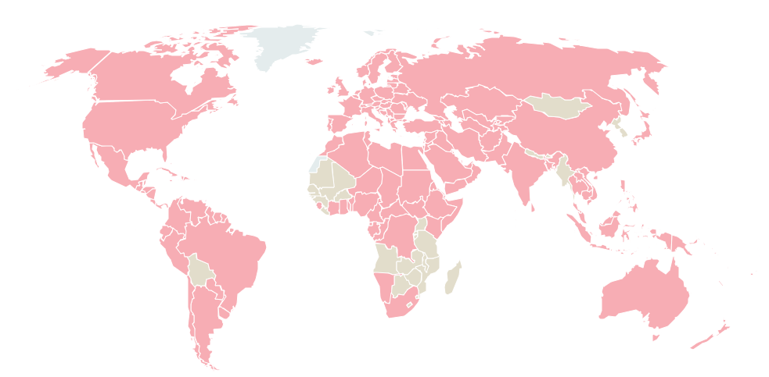
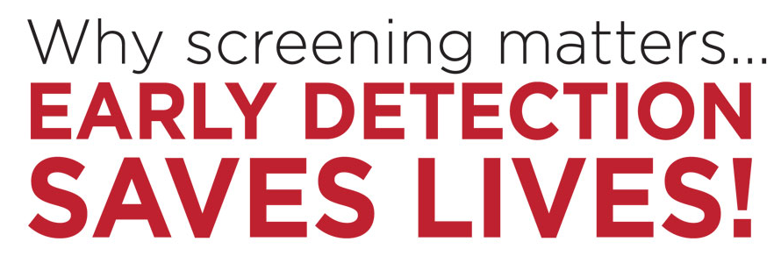
2.3 million women
Were diagnosed with breast cancer in 2020
4

Slide 5
Strategy
Theory/hypothesis
QUALITATIVE AND QUANTITAVE STRATEGY is applied for this research.
Data-Driven Approach
Measurable Performance Metrics
Statistical Analysis
Quantitative Validation
5

Slide 6
Qualitative Analysis – Theory and Hypothesis
The images we are dealing with:
are grayscale
have bigger size
have unnecessary dark background
1.Pre-trained models expect 3 channel color images (RGB)
Therefore, the traditional approaches with pretrained models may not deliver good results, since:
2. Images should be downsized to smaller size (224x224)
3.Classification models designed for multiclass classification
Consider this, we decide to build a custom approach for feature extraction and training.
6

Slide 7

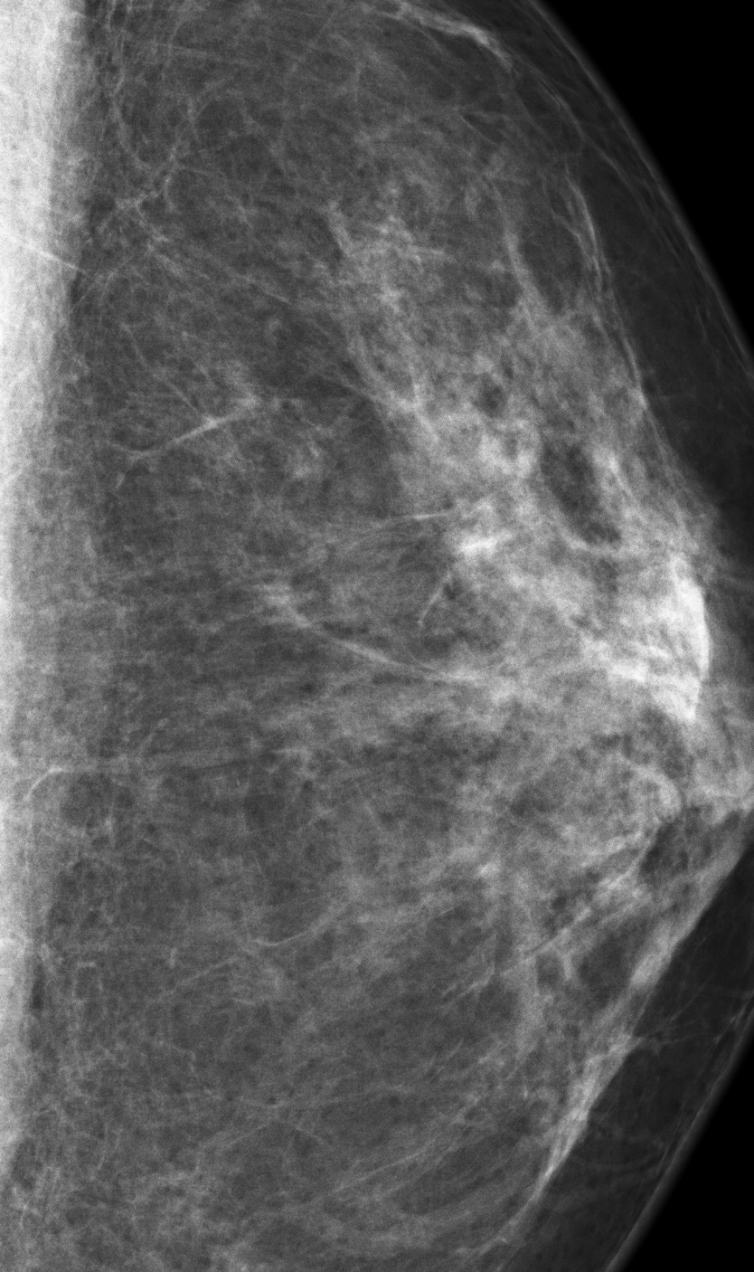
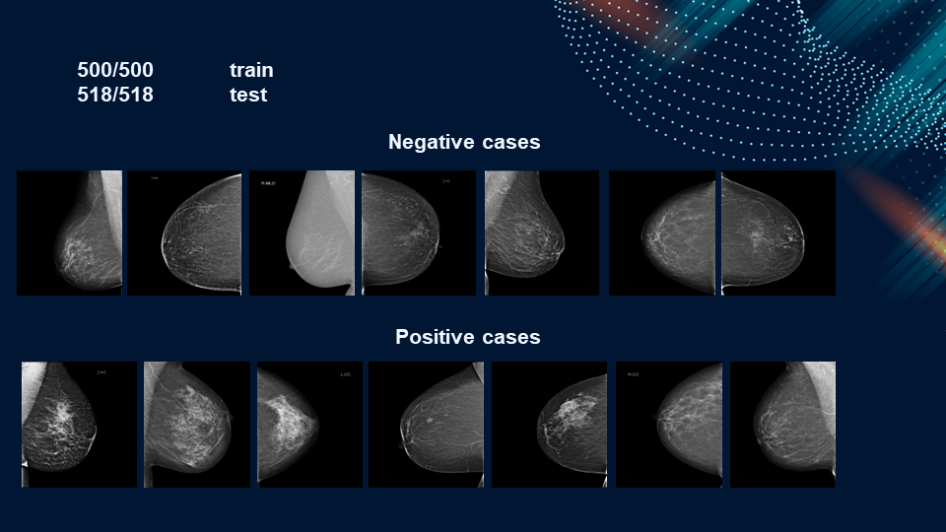
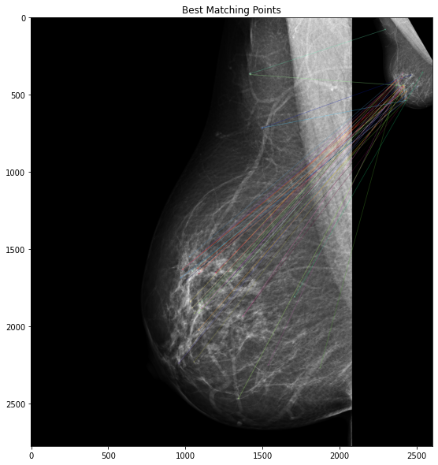
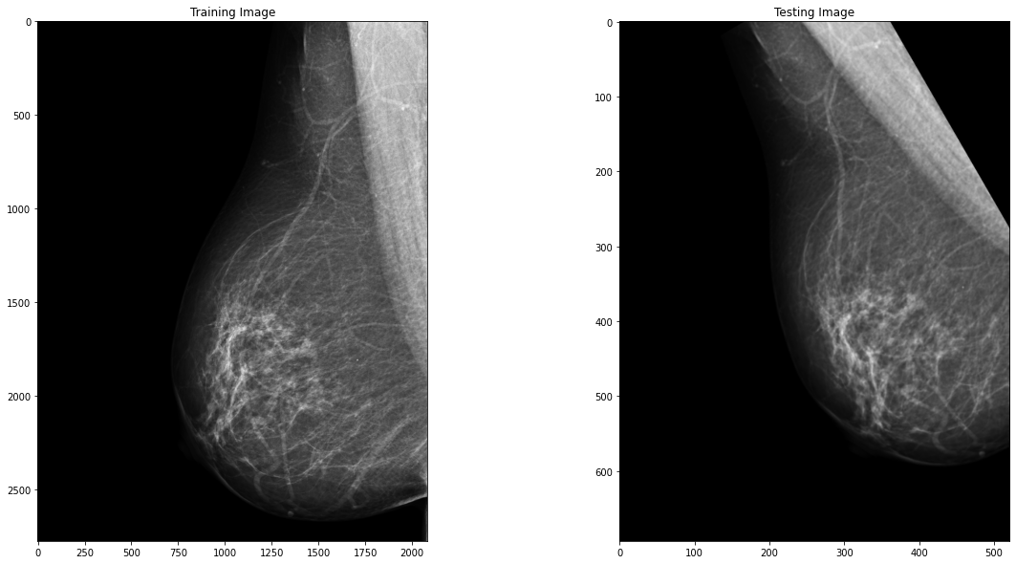
Architecture diagram
✗
✓
✓
Input: Descriptors
Output: 0 or 1
7

Slide 8
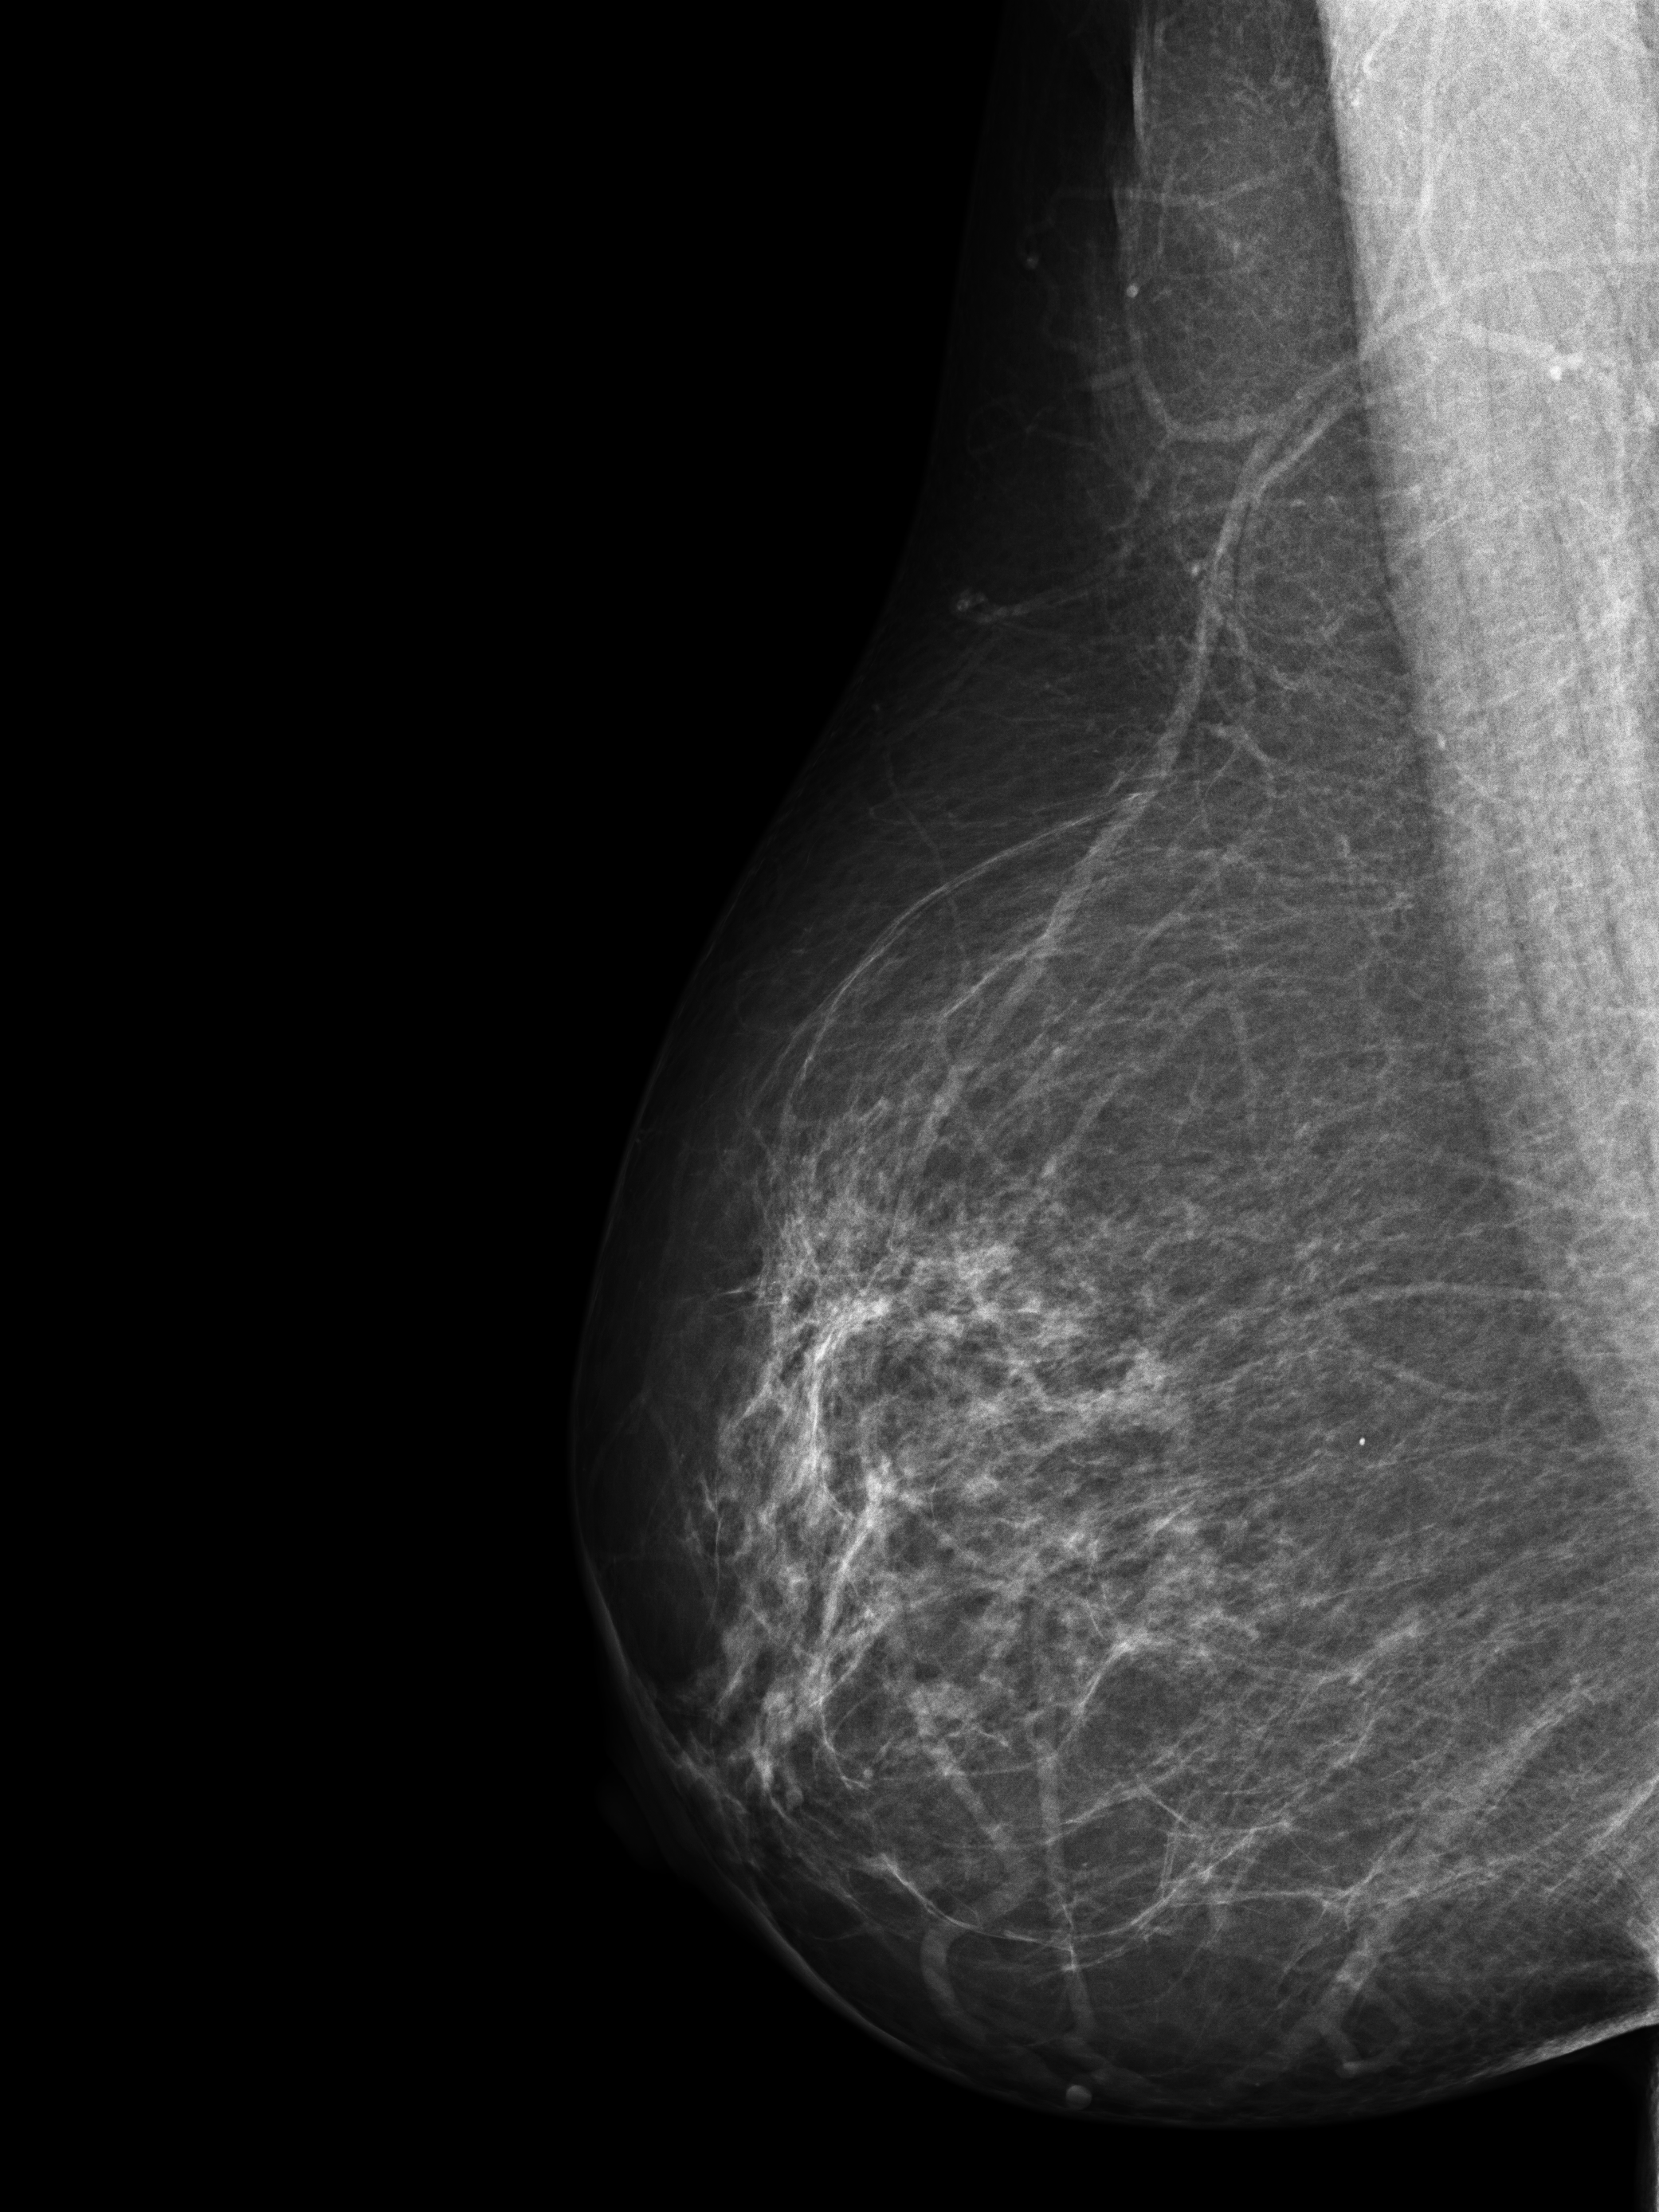
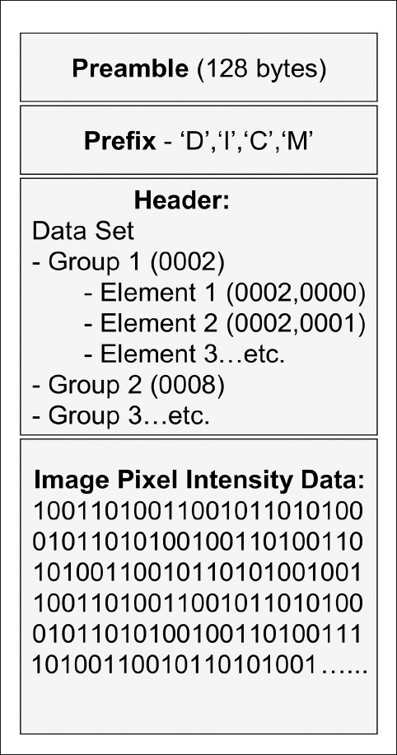
Challenges with image processing
Unlike standard image formats, DICOM files contain additional information such as patient data, imaging parameters, and acquisition details.
DICOM images typically contain between 12–16 bits/pixel, which corresponds to approximately 4,096 to 65,536 shades of gray¹. Most medical displays and regular computer screens are often limited to 8 bits or 256 shades of gray.
8

Slide 9
Data Collection
SOURCE of dataset:
RSNA Screening Mammography Breast Cancer
Positive
( 1158 )
Malignant cancer
Negative
( 53548 )
During Data cleansing process difficult negative cases were discarded.
Difficult negative case
Normal
( 7705 )
9

Slide 10

Data Selection
Positive
Negative
Train
500
518
500
518
Test
While data cleaning difficult negative cases were excluded. By excluding difficult negative cases, the goal is to create a more balanced and representative dataset that allows the model to focus on learning from the clear, well-defined negative instances
10

Slide 11
11

Slide 12
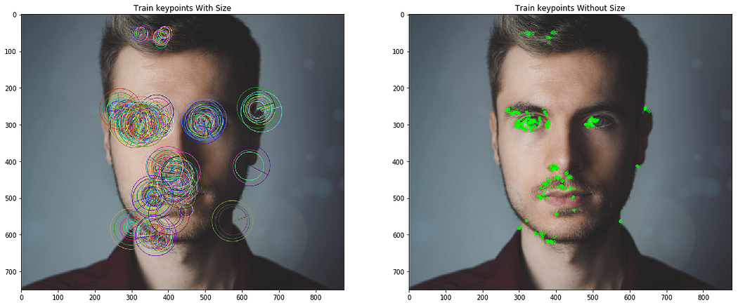
Feature extraction (ORB)
Oriented FAST and Rotated BRIEF (ORB) was developed at OpenCV labs in 2011, as an efficient and viable alternative to SIFT and SURF.
ORB performs as well as SIFT on the task of feature detection (and is better than SURF) while being almost two orders of magnitude faster.
ORB builds on the well-known FAST keypoint detector and the BRIEF descriptor.
12

Slide 13
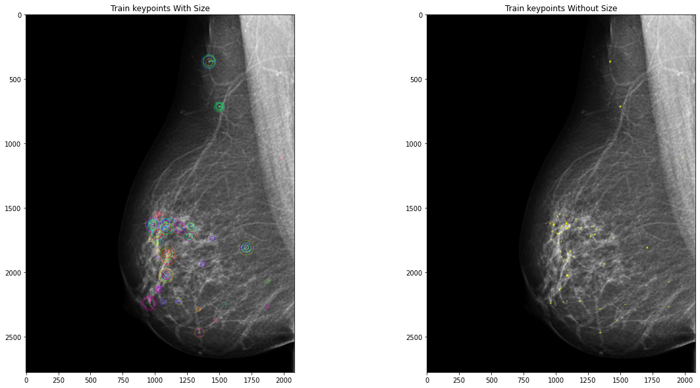
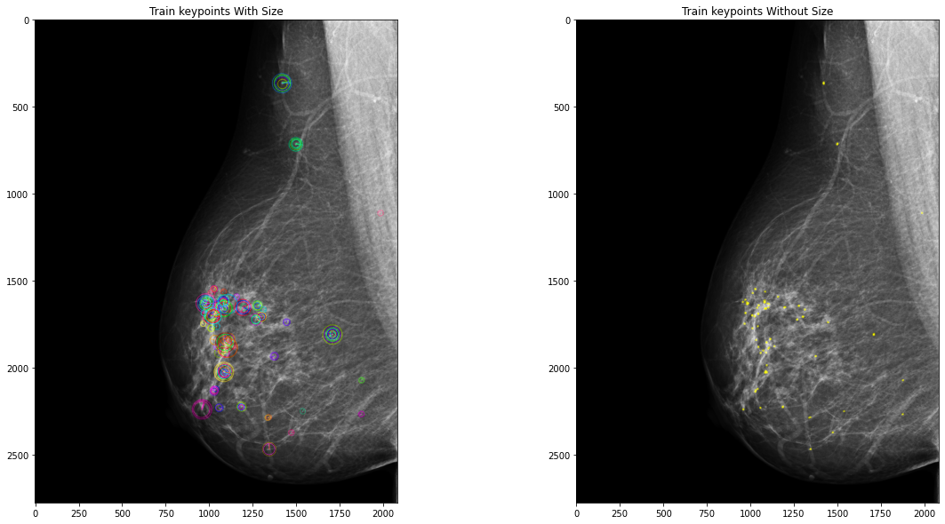
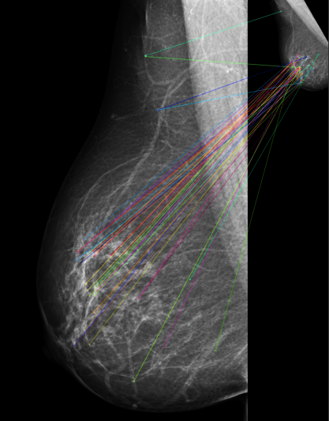
ORB applied to breast cancer
Extracted features which are given as input to models
Matched descriptors
array([[213, 92, 191, 249, 140, 111, 85, 142, 182, 91, 194, 16, 215,
247, 33, 107, 225, 243, 127, 16, 41, 205, 115, 50, 203, 235,
247, 4, 176, 121, 164, 34],
[125, 39, 93, 101, 176, 30, 102, 184, 96, 232, 59, 76, 211,
32, 137, 179, 54, 196, 76, 110, 233, 176, 237, 14, 164, 175,
37, 20, 104, 179, 74, 33],
….. ])
ORB_create(nfeatures=150)
Brute Force Matcher
13

Slide 14
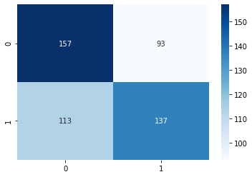
Results
137 | 113
68 | 182
143 | 107
65 | 185
 | Accuracy | Recall | Precision | F1 Score
Random Forest | 0.638 | 0.6683 | 0.548 | 0.6022
SVM | 0.656 | 0.6875 | 0.572 | 0.6245
KNN | 0.654 | 0.6667 | 0.616 | 0.6403
Logistic Regression | 0.588 | 0.548 | 0.5957 | 0.5708
154 | 96
77 | 173
14

Slide 15

Future work
The ORB (Oriented FAST and Rotated BRIEF) algorithm can extract a certain number of features from an image, limited by a maximum number of features it can detect.
Instead of directly training a model on these limited features, an alternative approach is to generate multiple augmentations of the same image, rotation and resizing by various degrees. Then, apply the ORB feature extraction on each augmented image.
We explore various closeness criteria such as Hamming distance, Levenshtein distance, and others to identify the most appropriate comparison rule, whether it involves comparing each descriptor to the original or among themselves.
The abstract is submitted for AAAE conference .
15

Slide 16


